Slide 1
UNIT-V
PART-1: Efficient Binary Search Trees
  AVL Trees
  Red-Black Trees
  Splay Trees
PART-2: Multiway Search Trees
  m-way search trees
  Searching an m-way search tree
  B-Trees
  Insertion into a B-Tree
  Deletion from a B-Tree

Slide 2
Part-1: Efficient Binary Search Trees
In computer science, a binary search tree (BST), also called an ordered or sorted binary tree, is a rooted binary tree whose internal nodes each store a key greater than all the keys in the node's left subtree and less than those in its right subtree.
A binary tree is a type of data structure for storing data such as numbers in an organized way. Binary search trees allow binary search for fast lookup, addition and removal of data items, and can be used to implement dynamic sets and lookup tables.
Some of the efficient binary search trees are
AVL trees and red-black trees are both forms of self-balancing binary search trees.
A splay tree is a binary search tree that automatically moves frequently accessed elements nearer to the root.

Slide 3
Efficient Binary Search Trees…
In a treap (tree heap), each node also holds a (randomly chosen) priority and the parent node has higher priority than its children.
Tango trees are trees optimized for fast searches.
T-trees are binary search trees optimized to reduce storage space overhead, widely used for in-memory databases.

Slide 4
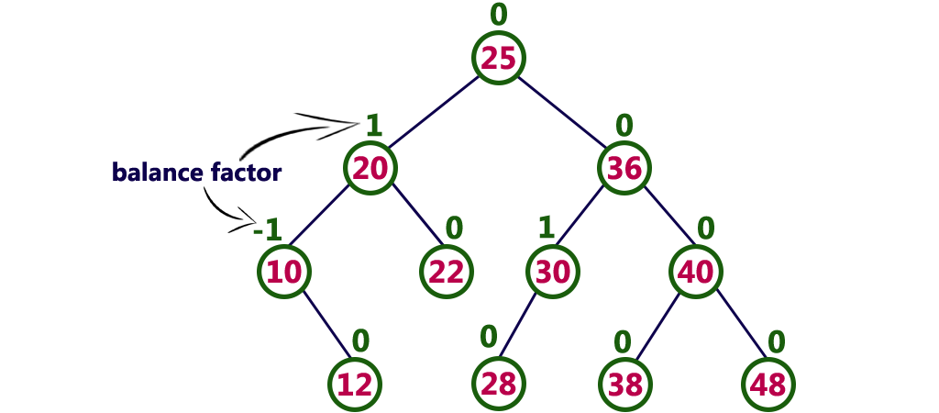
1. AVL Tree
AVL tree is a self balanced binary search tree, where the difference between the heights of left and right subtrees of every node in the tree is either -1, 0 or +1. The AVL tree was introduced in the year of 1962 by G.M. Adelson, Velsky and E.M. Landis.
In an AVL tree, every node maintains a extra information known as balance factor, which is is the difference between the heights of left and right subtrees of that node.
Balance factor = heightOfLeftSubtree - heightOfRightSubtree

Slide 5
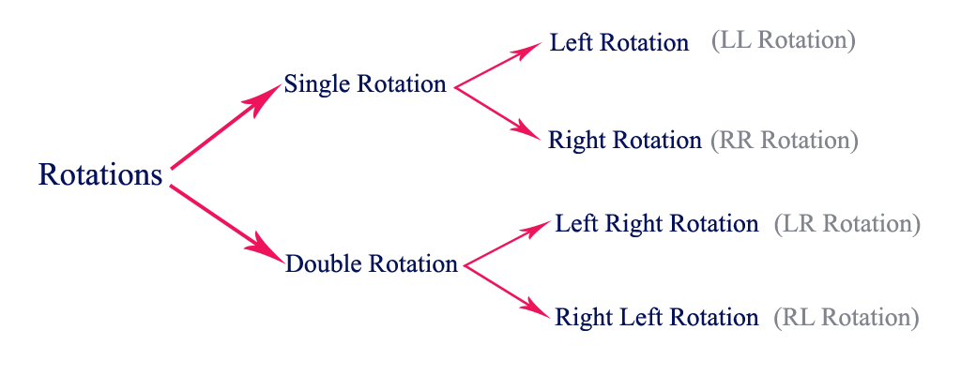
AVL Tree…
AVL Rotations: In AVL tree, after performing every operation like insertion and deletion, we need to check the balance factor of every node in the tree.
If every node satisfies the balance factor condition then we conclude the operation otherwise we must make it balanced.
We use rotation operations to make the tree balanced whenever the tree is becoming imbalanced due to any operation.
There are four rotations and they are classified into two types.

Slide 6
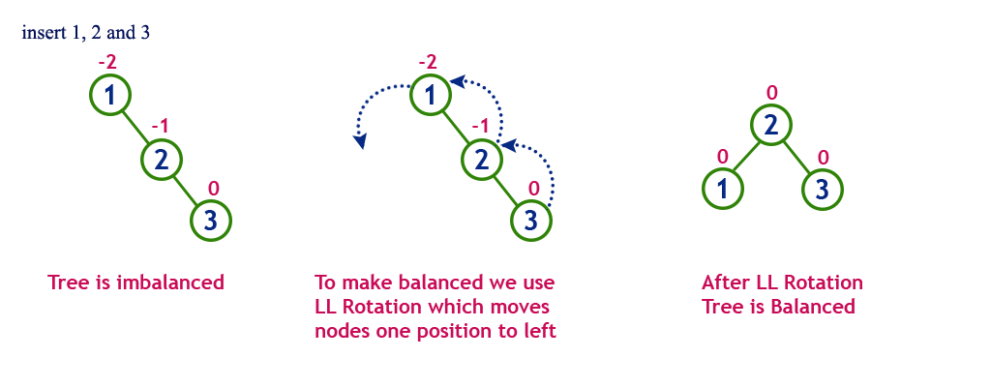
AVL Tree…
Single Left Rotations (LL):
In LL Rotation every node moves one position to left from the current position.
To understand LL Rotation, let us consider following insertion operations into an AVL Tree...

Slide 7
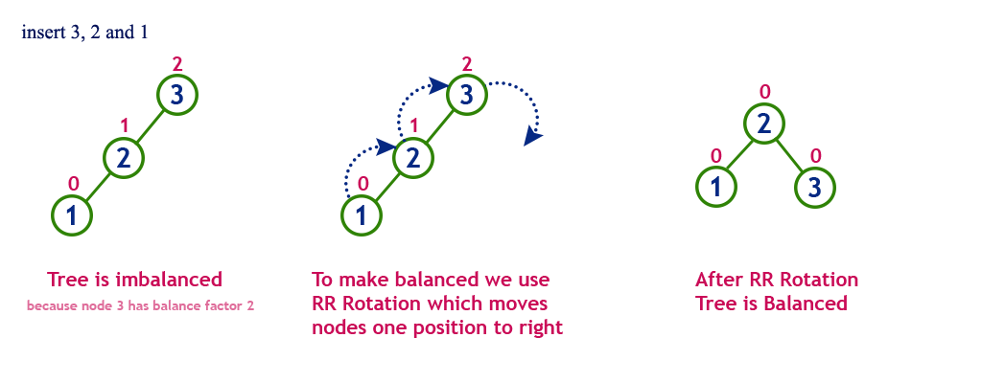
AVL Tree…
Single Right Rotations (RR):
In RR Rotation every node moves one position to right from the current position.
To understand RR Rotation, let us consider following insertion operations into an AVL Tree...

Slide 8
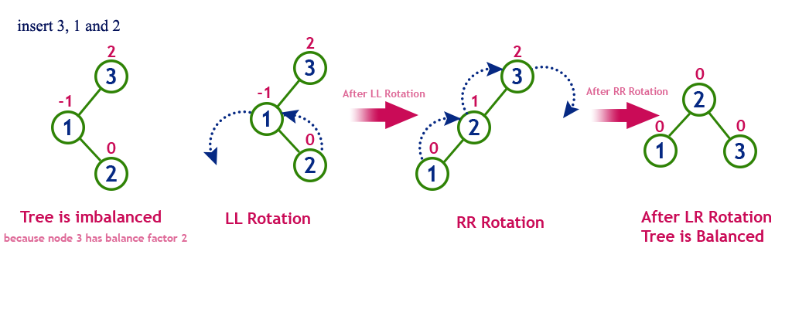
AVL Tree…
Left Right Rotations (LR): is combination of single left rotation followed by single right rotation.
In LR, first every node moves one position to left then one position to right from the current position. To understand LR Rotation, let us consider following insertion operations into an AVL Tree...

Slide 9
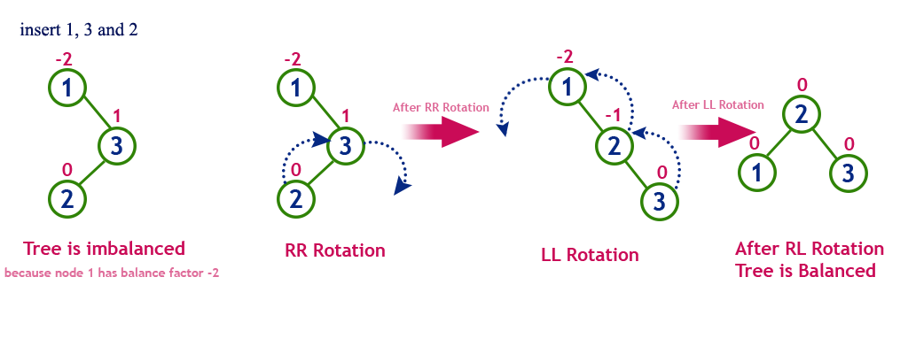
AVL Tree…
Right Left Rotations (RL): is combination of single right rotation followed by single left rotation.
In RL, first every node moves one position to right then one position to left from the current position. To understand RL, let us consider following insertion operations into an AVL Tree…

Slide 10
2. Red-Black Trees
Red - Black Tree is another variant of Binary Search Tree in which every node is colored either RED or BLACK. In a Red Black Tree the color of a node is decided based on the Red Black Tree properties.
Properties of Red Black Tree
  Property #1: Red - Black Tree must be a Binary Search Tree.
  Property #2: The ROOT node must colored BLACK.
  Property #3: The children of Red colored node must colored BLACK. (There should not be two consecutive RED nodes).
  Property #4: In all the paths of the tree there must be same number of BLACK colored nodes.
  Property #5: Every new node must inserted with RED color.
  Property #6: Every leaf (i.e. NULL node) must colored BLACK.
Every Red Black Tree is a binary search tree, but all the Binary
Search Trees need not to be Red Black trees.

Slide 11
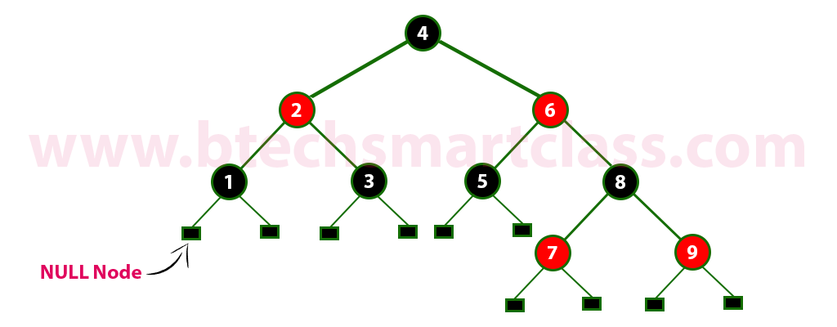
Red-Black Trees…
The following is a Red Black Tree which created by inserting numbers from 1 to 9.
The above tree is a Red Black tree and every node is satisfying all
the properties of Red Black Tree.

Slide 12
Red-Black Trees…
Insertion Operation:
The insertion operation in Red Black tree is performed using following steps...
  Step 1: Check whether tree is Empty.
  Step 2: If tree is Empty then insert the newNode as Root node with color Black and exit from the operation.
  step 3: If tree is not Empty then insert the newNode as a leaf node with Red color.
  Step 4: If the parent of newNode is Black then exit from the operation.
  Step 5: If the parent of newNode is Red then check the color of parent node's sibling of newNode.
  Step 6: If it is Black or NULL node then make a suitable Rotation and Recolor it.
  Step 7: If it is Red colored node then perform Recolor and Recheck it. Repeat the same until tree becomes Red Black Tree.

Slide 13
Red-Black Trees…
Deletion Operation:
In a Red Black Tree, the deletion operation is similar to deletion operation in BST.
But after every deletion operation we need to check with the Red Black Tree properties.
If any of the property is violated then make suitable operation like Recolor or Rotation & Recolor.

Slide 14
3. Splay Trees
Splay tree is another variant of binary search tree, in which, the recently accessed element is placed at the root of the tree.
Splay Tree is a self - adjusted Binary Search Tree in which every operation on an element rearrange the tree so that the element is placed at the root position of the tree.
All the operations on a splay tree are involved with a common operation called "Splaying” i.e. the process of bringing it to the root position by performing suitable rotation operations.
With the help of splaying an element we can bring most frequently used element closer to the root of the tree so that any operation on those element performed quickly.
That means the splaying operation automatically brings more frequently used elements closer to the root of the tree.

Slide 15
Splay Trees…
In a splay tree, to splay any element we use the following rotation operations...
  Zig Rotation
  Zag Rotation
  Zig - Zig Rotation
  Zag - Zag Rotation
  Zig - Zag Rotation
  Zag - Zig Rotation
Zig Rotation: it is similar to the single right rotation in AVL Tree rotations. In zig rotation every node moves one position to the right from its current position. Consider the following example…

Slide 16
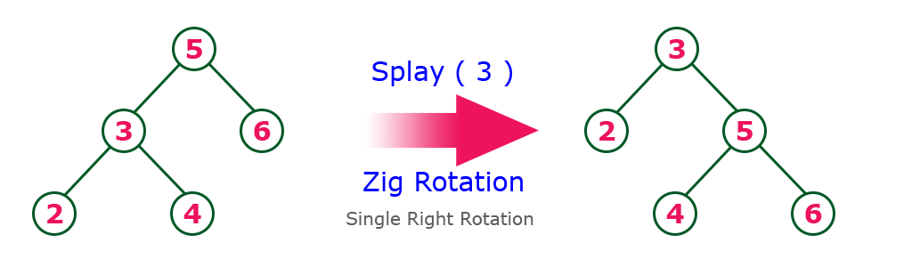
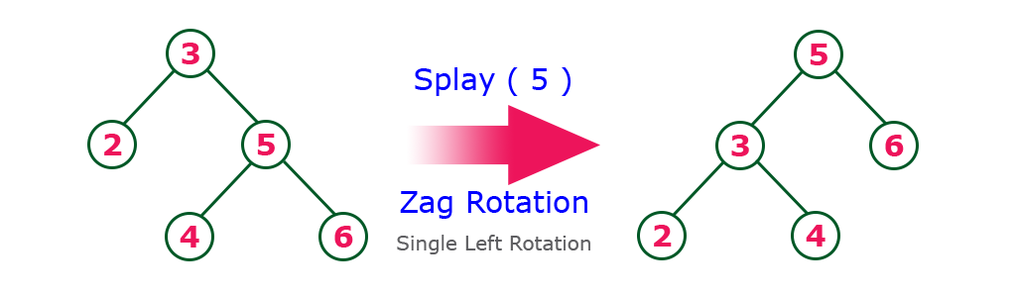
Splay Trees…
Zag Rotation: it is similar to the single left rotation in AVL Tree rotations. In zag rotation every node moves one position to the left from its current position. Consider the following example…

Slide 17
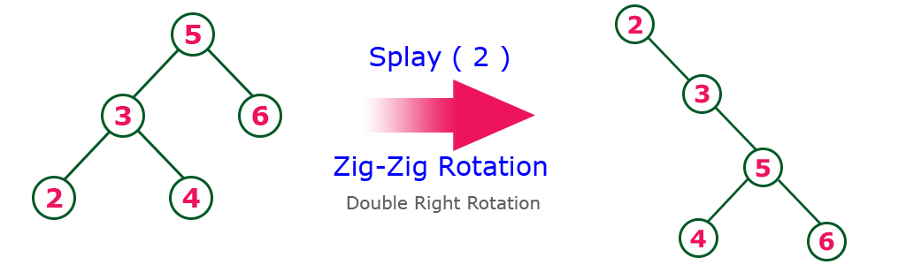
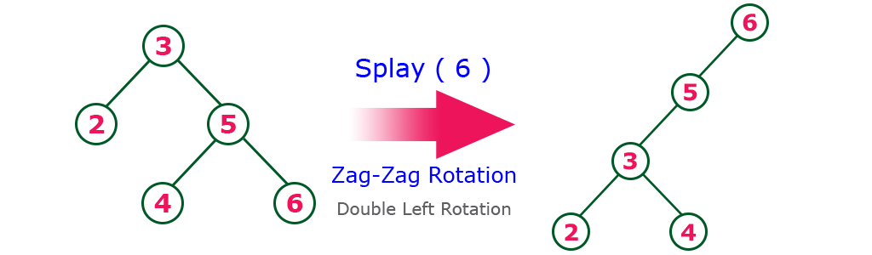
Splay Trees…
Zig-Zig Rotation: is a double zig rotation. In this, every node moves two position to the right from its current position.
Zag-Zag Rotation: is a double zag rotation. In this, every node moves two position to the left from its current position.

Slide 18
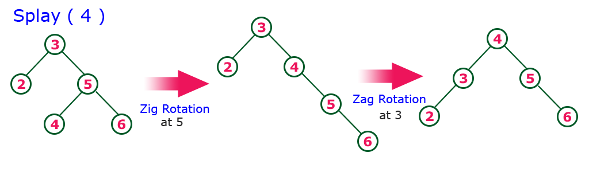
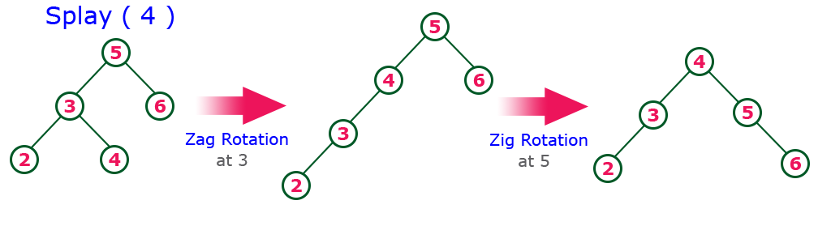
Splay Trees…
Zig-Zag Rotation: is a sequence of zig rotation followed by zag rotation. In this, every node moves one position to the right followed by one position to the left from its current position.
Zag-Zig Rotation: is a sequence of zag rotation followed by zig rotation. In this, every node moves one position to the left followed by one position to the right from its current position..

Slide 19
Splay Trees…
Insertion Operation: performed uses following steps...
  Step 1: Check whether tree is Empty.
  Step 2: If tree is Empty then insert the newNode as Root node and exit from the operation.
  step 3: If tree is not Empty then insert the newNode as a leaf node using Binary Search tree insertion logic.
  Step 4: After insertion, Splay the newNode
Deletion Operation: in a Splay Tree, the deletion operation is similar to deletion operation in Binary Search Tree.
But before deleting the element first we need to splay that node then delete it from the root position then join the remaining tree.

Slide 20
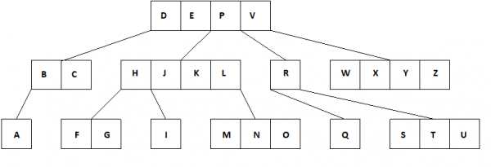
4. Multi-way (m-way) Search Trees
A multiway tree is defined as a tree that can have more than two children. If a multiway tree can have maximum m children, then this tree is called as multiway tree of order m (or an m-way tree).
As with the other trees that have been studied, the nodes in an m-way tree will be made up of m-1 key fields and pointers to children.
multiway tree of order 5:

Slide 21
Multi-way (m-way) Search Trees…
To make the processing of m-way trees easier some type of constraint or order will be imposed on the keys within each node, resulting in a multiway search tree of order m (or an m-way search tree).
By definition an m-way search tree is a m-way tree in which following condition should be satisfied −
  Each node is associated with m children and m-1 key fields
  The keys in each node are arranged in ascending order.
  The keys in the first j children are less than the j^{th} key.
  The keys in the last m-j children are higher than the j^{th} key.

Slide 22
5. Searching an m-way search tree
The m-way search trees are multi-way trees which are generalised versions of binary trees where each node contains multiple elements. In an m-Way tree of order m, each node contains a maximum of m – 1 elements and m children.
The goal of m-Way search tree of height h calls for O(h) no. of accesses for an insert/delete/retrieval operation. Hence, it ensures that the height h is close to log_m(n + 1).
The number of elements in an m-Way search tree of height h ranges from a minimum of h to a maximum of m^{h}-1.
An m-Way search tree of n elements ranges from a minimum height of log_m(n+1) to a maximum of n
An example of a 5-Way search tree is shown in the figure below. Observe how each node has at most 5 child nodes & therefore has at most 4 keys contained in it.
  .

Slide 23
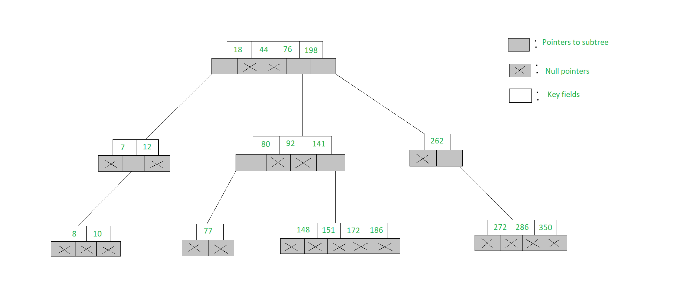
Searching an m-way search tree…
To search for 77 in the 5-Way search tree, shown in the figure, we begin at the root & as 77> 76> 44> 18, move to the fourth sub-tree
In the root node of the fourth sub-tree, 77< 80 & therefore we move to the first sub-tree of the node. Since 77 is available in the only node of this sub-tree, we claim 77 was successfully searched.

Slide 24
6. B-Trees
In a binary search tree, AVL Tree, Red-Black tree etc., every node can have only one value (key) and maximum of two children.
But there is another type of search tree called B-Tree in which a node can store more than one value (key) and it can have more than two children.
B-Tree was developed in the year of 1972 by Bayer and McCreight with the name Height Balanced m-way Search Tree. Later it was named as B-Tree.
B-Tree can be defined as a self-balanced search tree with multiple keys in every node and more than two children for every node.
Here, number of keys in a node and number of children for a node is depend on the order of the B-Tree. Every B-Tree has order.

Slide 25
B-Trees …
B-Tree of Order m has the following properties...
Property #1 - All the leaf nodes must be at same level.
Property #2 - All nodes except root must have at least [m/2]-1 keys and maximum of m-1 keys.
Property #3 - All non leaf nodes except root (i.e. all internal nodes) must have at least m/2 children.
Property #4 - If the root node is a non leaf node, then it must have at least 2 children.
Property #5 - A non leaf node with n-1 keys must have n number of children.
Property #6 - All the key values within a node must be in Ascending Order.

Slide 26
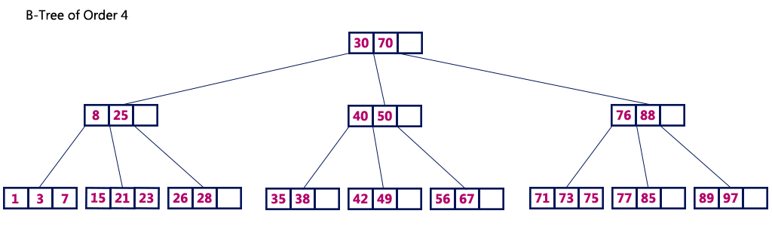
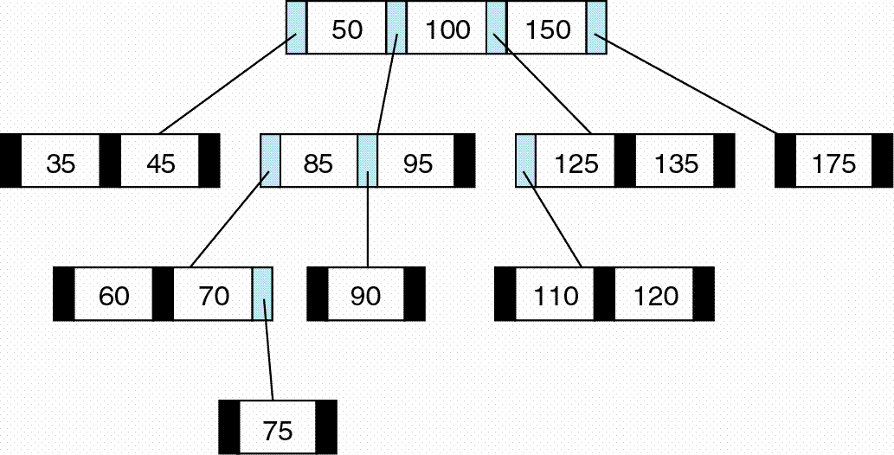
B-Trees …
For example, B-Tree of Order 4 contains maximum 3 key values in a node and maximum 4 children for a node.

Slide 27
B-Tree – Search Operation
In a B-Tree, the search operation is similar to that of Binary Search Tree, where search process starts from the root node but every time we make n-way decision where n is the total number of children that node has.
In a B-Tree, the search operation is performed with O(log n) time complexity.
  Step 1: Read the search element from the user
  Step 2: Compare, the search element with first key value of root node in the tree.
  Step 3: If both are matching, display “Node found!!!" and terminate the function
  Step 4: If both are not matching, then check search element is smaller or larger than that key value.
  Step 5: If search element is smaller, then continue the search process in left subtree.
  Step 6: If search element is larger, then compare with next key value in the same node and repeat step 3, 4, 5 and 6 until we found exact match or comparison completed with last key value in a leaf node.
  Step 7: If we completed with last key value in a leaf node, then display "Element is not found" and terminate the function.

Slide 28
7. Insertion into a B-Tree
In a B-Tree, always the new keyValue is attached to leaf node only. The insertion operation is performed as follows...
  Step 1: Check whether tree is Empty.
  Step 2: If tree is Empty, then create a new node with new key value and insert into the tree as a root node.
  Step 3: If tree is Not Empty, then find a leaf node to which the new key value can be added using Binary Search Tree logic.
  Step 4: If that leaf node has an empty position, then add the new key value to that leaf node by maintaining ascending order of key value within the node.
  Step 5: If that leaf node is already full, then split that leaf node by sending middle value to its parent node. Repeat the same until sending value is fixed into a node.
  Step 6: If the splitting is occurring to the root node, then the middle value becomes new root node for the tree and the height of the tree is increased by one.

Slide 29
Insertion into a B-Tree …
Steps for insertion in B+ Tree:
Every element is inserted into a leaf node. So, go to the appropriate leaf node.
Insert the key into the leaf node in increasing order only if there is no overflow. If there is an overflow go ahead with the following steps mentioned below to deal with overflow while maintaining the B+ Tree properties.
Case 1: Overflow in leaf node
Split the leaf node into two nodes.
First node contains ceil((m-1)/2) values.
Second node contains the remaining values.
Copy the smallest search key value from second node to the parent node.(Right biased)

Slide 30
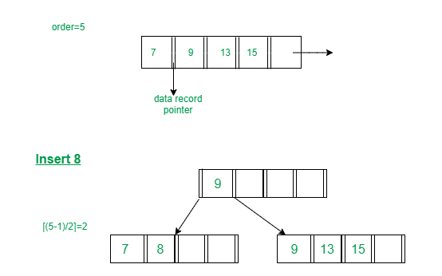
Insertion into a B-Tree …
Below is the illustration of inserting 8 into B+ Tree of order of 5:

Slide 31
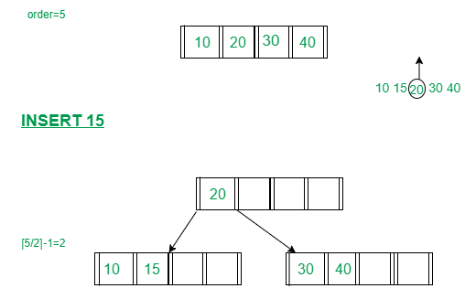
Insertion into a B-Tree …
Case 2: Overflow in non-leaf node
Split the non leaf node into two nodes.
First node contains ceil(m/2)-1 values.
Move the smallest among remaining to the parent.
Second node contains the remaining keys.
Below is the illustration of inserting 15 into B+ Tree of order of 5:

Slide 32
8. Deletion from a B-Tree
Deletion from a B-tree is more complicated than insertion. When we delete a key from an internal node, we will have to rearrange the node’s children. We sketch how deletion works with various cases of deleting keys from a B-tree.
1. If the key k is in node x and x is a leaf, delete the key k from x.
2. If the key k is in node x and x is an internal node, do the following.
a) If the child y that precedes k in node x has at least t keys, then find the predecessor k0 of k in the sub-tree rooted at y. Recursively delete k0, and replace k by k0 in x. (We can find k0 and delete it in a single downward pass.)
b) If y has fewer than t keys, then, symmetrically, examine the child z that follows k in node x. If z has at least t keys, then find the successor k0 of k in the subtree rooted at z. Recursively delete k0, and replace k by k0 in x. (We can find k0 and delete it in a single downward pass.)
c) Otherwise, if both y and z have only t-1 keys, merge k and all of z into y, so that x loses both k and the pointer to z, and y now contains 2t-1 keys. Then free z and recursively delete k from y.

Slide 33
Deletion from a B-Tree …
3. If the key k is not present in internal node x, determine the root x.c(i) of the appropriate subtree that must contain k, if k is in the tree at all. If x.c(i) has only t-1 keys, execute step 3a or 3b as necessary to guarantee that we descend to a node containing at least t keys. Then finish by recursing on the appropriate child of x.
a) If x.c(i) has only t-1 keys but has an immediate sibling with at least t keys, give x.c(i) an extra key by moving a key from x down into x.c(i), moving a key from x.c(i) ’s immediate left or right sibling up into x, and moving the appropriate child pointer from the sibling into x.c(i).
b) If x.c(i) and both of x.c(i)’s immediate siblings have t-1 keys, merge x.c(i) with one sibling, which involves moving a key from x down into the new merged node to become the median key for that node.

Slide 34
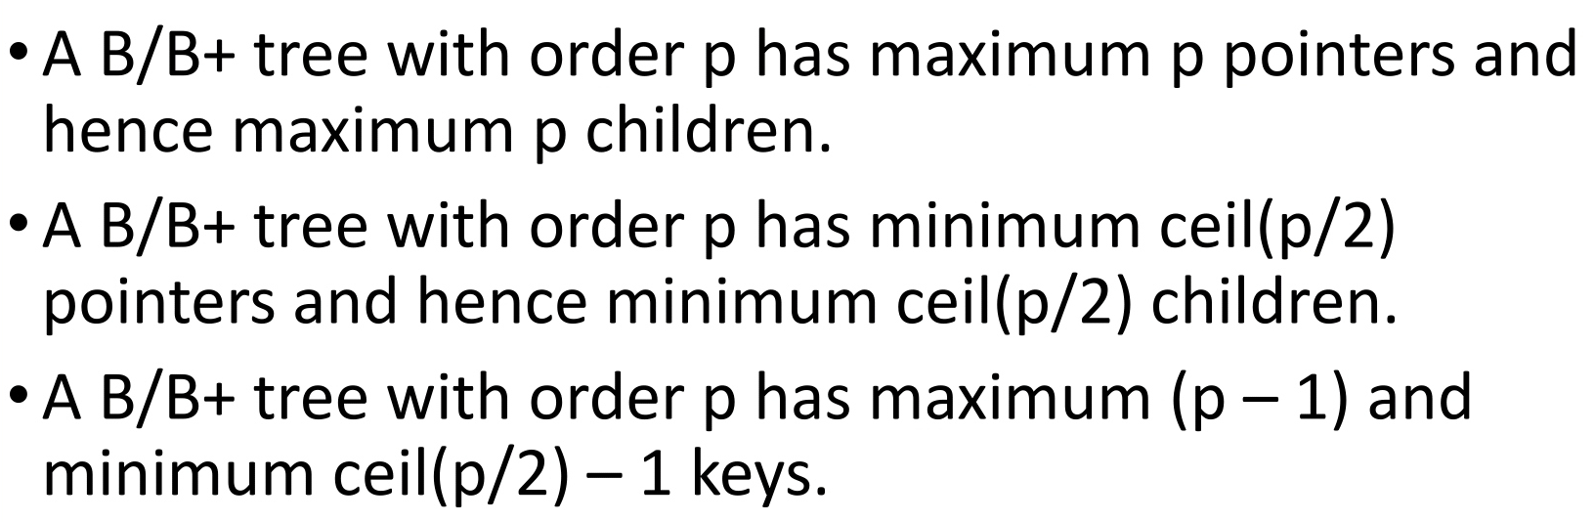
NOTE

Slide 35
END OF
UNIT-5

